Slide 1
Introduction to Web Design

Slide 2
Creating your Web Site Technologies & Tools
Markup Languages
HTML, DHTML, XML, XSLT, etc....
Cascading Style Sheets (CSS) : is a language that describes the style of an HTML document.
Scripting languages
perl, javascript, php, Python,etc....
Web creation and editing software
Notepad, FrontPage, Coldfusion, Flash, Hotmetal, Site Builder, etc..

Slide 3
Markup Languages - HTML
Derived from SGML
(Standard Generalized Markup Language )
HyperText Markup Language
Anatomy of a Website
Content: Text, Media
+ HTML: Structure + Semantics
+ CSS(Cascading Style Sheets): Presentation + Design
+ JS: Interactivity
= Your Website

Slide 4
HTML Fundamentals
Clear text, case insensitive
Ignores white space
Comprised of tags <tag />
Open tags and closed tags

Slide 5
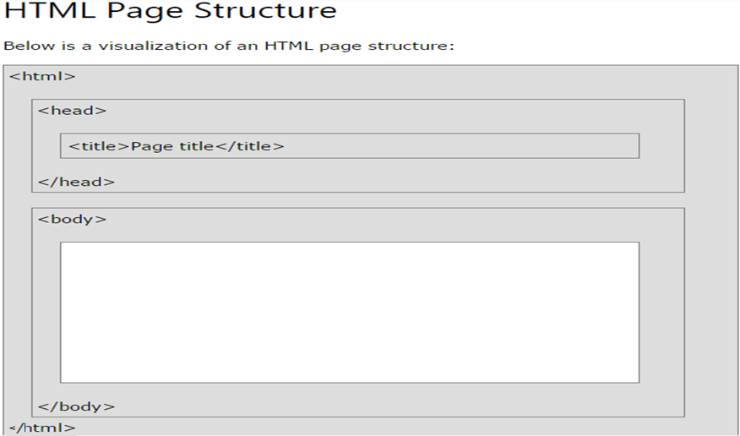

Slide 6
HTML – Fundamentals Document Structure
< <HTML> >
Header optional
Body
</HTML>

Slide 7
HTML – Fundamentals Basic Structure
<html>
<head>
<title> The title of your html page </title>
<meta_tags/>
</head>
<body>
<! - - your web page content and markup - ->
</body>
</html>
Optional

Slide 8
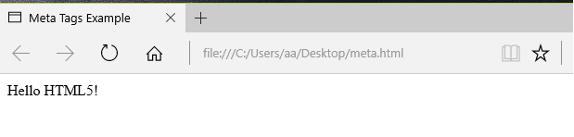
<meta> tag
The <meta> tag is used to provide such additional information and does not have a closing tag but it carries information within its attributes
2. You can add metadata to your web pages by placing <meta> tags inside the header of the document which is represented by <head> and </head> tags.
<html>
<head>
<title> Meta Tags Example </title> <meta charset="UTF-8"> <meta name="description" content=" Learning about Meta Tags. "> <meta name="keywords" content= "HTML, Meta Tags, Metadata "> <meta name="author" content= " Ali Sami"> </head>
<body>
<p> Hello HTML5! </p>
</body>
</html>

Slide 9
HTML Tag
Each tag has a “start tag”, “end tag”, some content in between, and optional attributes.
Syntax:
<tag_name attribute1="value" attribute2="value">
content
</tagname>
Example:
<a href="http://www.google.com" >
Google
</a>

Slide 10
HTML - Fundamentals
Open tags
<name attributes/>
<hr/>, <br/>
<img src=“url” width=‘100px’ height=’60px’/>
Closed tags
<name attributes> stuff </name>
<b> text to be bolded </b>
<h1> level 1 heading text </h1>
Comments <! comment text >
HTML comments are placed in between <!-- ... --> tags.
There are no spaces in the start-of-comment string.
Comments do not nest which means a comment can not be put inside another comment.

Slide 11
Valid Comment Example
<html>
<head>
<title>Valid Comment Example</title>
</head>
<body> <!-- This is valid comment -->
<p>Document content goes here.....</p>
</body>
</html>

Slide 12

Color Codes
Colors are set using “RGB” color codes, which are, represented as hexadecimal values.
Each 2-digit section of the code represents the amount, in sequence, of red, green or blue that forms the color.
For example, a RGB value with 00 as the first two digits has no red in the color.

Slide 13
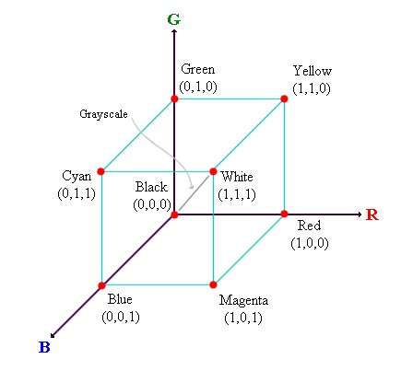
RGB Colors Model

Slide 14
HTML – Fundamentals Colors
color = “red” (Browser compatibility issues)
color = “#FF0000”
values vary from 00 to FF (hexadecimal)
0,1,2,3,4,5,6,7,8,9,a,b,c,d,e,f
#FF FF FF
Red
Blue
Green

Slide 15
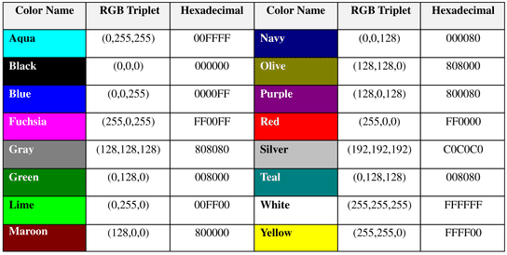
16 Basic Colors

Slide 16
Color Codes
WHITE
BLACK
RED
GREEN
BLUE
MAGENTA
CYAN
YELLOW
AQUAMARINE
BAKER’S CHOCOLATE
VIOLET
BRASS
COPPER
PINK
ORANGE
#FFFFFF
#000000
#FF0000
#00FF00
#0000FF
#FF00FF
#00FFFF
#FFFF00
#70DB93
#5C3317
#9F5F9F
#B5A642
#B87333
#FF6EC7
#FF7F00

Slide 17
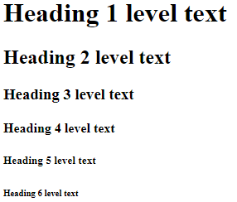
HTML – Fundamentals Headings
Renders text as a heading, the rendering depending on the level of heading selected. Headings should be automatically spaced from the body text.
<html>
<body>
<h1>Heading 1 level text</h1>
<h2>Heading 2 level text</h2>
<h3>Heading 3 level text</h3>
<h4>Heading 4 level text</h4>
<h5>Heading 5 level text</h5>
<h6>Heading 6 level text</h6>
</body>
</html>

Slide 18
HTML – Fundamentals <p> tag (paragraph)
P tag Optional Attributes
Attribute | Value | Description
align | left right center justify | Specifies the alignment of the text within a paragraph

Slide 19
HTML – Fundamentals <font> tage
<font Attribute > text </font>
Font tag Optional Attributes
Attribute | Value | Description
color | rgb(x,x,x) #xxxxxx color name | Specifies the color of text
face | font_family | Specifies the font of text such as Arial, Times, Courier
size | number | Specifies the size of text

Slide 20
HTML – Fundamentals < A > Link tag
1) The tags used to produce links are the <A> and </A>.
The <A> tells where the link should start and
the </A> indicates where the link ends.
Everything between these two will work as a link.
2) The example below shows how to make the word
here work as a link to yahoo by using hypertext reference attribute (HREF).
Click <A HREF="http://www.yahoo.com">here</A> to go to yahoo.
Attributes
NAME = “text”
TITLE = "text"
TARGET = “frame_name|window_name”

Slide 21
HTML – Fundamentals ANCHORS (Hypertext Link)
<A href=“url” attributes> Displayed text </A>
Syntax
<a href="URL">
The URL of the link possible values:
An absolute URL - points to another web site (like href="http://www.example.com/default.htm")
A relative URL - points to a file within a web site (like href="default.htm")
Link to an element with a specified id within the page (like href="#top")
Other protocols (like https://, ftp://, mailto:, file:, etc..)
A script (like href="javascript:alert('Hello');")

Slide 22
HTML – Fundamentals Hypertext links
<a href=“mywebpage.html” target=“window2” >Click this link </a>
Click this link
opens mywebpage.html in the window / frame named “window2”
window2

Slide 23
E-Mail (Electronic Mail)
<A HREF=“mailto:ali@yahoo.com”>Send me More Information </A>

Slide 24
HTML – Fundamentals <body> tag
The <body> element contains all the contents of an HTML document, such as text, hyperlinks, images, tables, lists, etc.
<body>
….. contents of an HTML document …
</body>
Attribute of body tag | Value | Description
alink | color | Specifies the color of an active link in a document
vlink | color | Specifies the color of visited links in a document
link | color | Specifies the color of unvisited links in a document
background | URL | Specifies a background image for a document
bgcolor | color | Specifies the background color of a document
text | color | Specifies the color of the text in a document

Slide 25
HTML – Fundamentals Hyperlink Colors
<BODY LINK=“color”, VLINK=“color”, ALINK=“color “>
<BODY LINK=“blue”, VLINK=“purple”, ALINK=“red” >
<BODY LINK=“#0000FF”, VLINK=“#FF00FF”, ALINK=“#FF0000” >

Slide 26
HTML – Fundamentals Other uses of Images
Page background (not recommended)
<body background-image = “url” >
<body class=“background”>
body.background { background-image:$url; }

Slide 27
background-image
<html>
<head>
<style>
body {
background-image: url(' it-logo.jpeg');
background-repeat: no-repeat;
}
</style></head>
<body>
<h2>Background No Repeat repeated by setting the background- repeat property to "no-repeat </h2>
</body>
</html>

Slide 28
background-image
<html>
<head>
<style>
body {
background-image: url(' it-logo.jpeg');
background-repeat: no-repeat;
background-attachment: fixed;
background-size: cover; or background-size: 100% 100%;
}
</style></head>
<body>
<h2>Background Cover : background-size property </h2>
</body>
</html>

Slide 29
Img tag attributes
Attribute | Value | Description
align | top bottom middle left right | Specifies the alignment of an image according to surrounding elements
alt | text | Specifies an alternate text for an image
border | pixels | Specifies the width of the border around an image
height | pixels | Specifies the height of an image
hspace | pixels | Not supported in HTML5. Specifies the whitespace on left and right side of an image
src | URL | Specifies the URL of an image
yspace | pixels | Not supported in HTML5. Specifies the whitespace on top and bottom of an image
width | pixels | Specifies the width of an image

Slide 30
HTML – Fundamentals Images-examples
1- <img src="images/ it-logo.jpeg" width=75px, height=50px >
2-
<img src=" it-logo.jpeg" alt="it-logo" width="500" height="600">
<img src=" it-logo.jpeg" alt="it-logo" style="width:500px;height:600px;">
3- <img class="pics" src="images/ it-logo.jpeg" >
img.pics { width:75px; height:50px; border-width:3px }

Slide 31
HTML – Fundamentals Using Images
Images take longer to download than text
The larger the image, the slower the page
Use optimization software
Use thumb nail images

Slide 32
HTML – Fundamentals Hypertext links
<a href=“page.html” target=“_blank” >Click this link </a>
Creates new window for the page
<a href=“page.html” target=“_parent” >Click this link </a>
Opens page in the parent frame/wind of this frame/window
<a href=“page.html” target=“_top” >Click this link </a>
Opens page in top most frame/window

Slide 33

HTML – Fundamentals Example
<body>
Mike Tyler
PO Box 190387
Hungry Horse, Mt 59919
</body>
<body>
<b>Mike Tyler</b> <br>
PO Box 190387<br>
Hungry Horse, Mt 59919<br>
</body>

Slide 34

HTML – Fundamentals Example…
<body>
<font face="Courier" color="red" size=“4">
<b>Mike Tyler</b><br>
PO Box 190387<br>
Hungry Horse, Mt 59919<br>
</font>
</body>
Font tag Optional Attributes
Attribute | Value | Description
color | rgb(x,x,x) #xxxxxx colorname | Specifies the color of text
face | font_family | Specifies the font of text such as Arial, Times, Courier
size | number | Specifies the size of text

Slide 35

HTML – Fundamentals Example…
<body>
<h3> Heading 3 </h3>
<p align="center">
<font face="Arial" color="blue" size="3">
<b>Mike Tyler</b><br>
PO Box 190387<br>
Hungry Horse, Mt 59919<br>
</font>
</p>
</body>
P tag Optional Attributes
Attribute | Value | Description
align | left right center justify | Specifies the alignment of the text within a paragraph

Slide 36
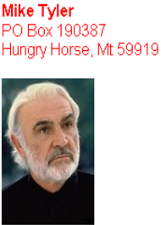
HTML – Fundamentals Example…
<body>
<p align='center'>
<font face="Arial,Lucida Sans" color="red" size="3">
<b>Mike Tyler</b><br>
PO Box 190387<br>
Hungry Horse, Mt 59919<br>
</font>
</p>
<img src='http://www.myserver.com/images/mike.jpg'>
</body>

Slide 37
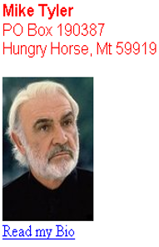
HTML – Fundamentals Example…
<body>
<p align=‘center’>
<font face=‘Arial,Lucida Sans’ color=‘red’ size=3>
<b>Mike Tyler</b><br>
PO Box 190387<br>
Hungry Horse, Mt 59919<br>
</font>
</p>
<img src=‘http://www.domain.com/images/mike.jpg’>
<a href=‘biopage.html’>Read my Bio</a>
</body>

Slide 38
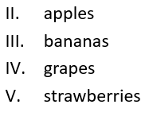
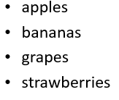
HTML – Fundamentals Lists
Unordered list
<ul>
<li>apples</li>
<li>bananas</li>
<li>grapes</li>
<li>strawberries</li>
</ul>
Ordered list
<ol type='I‘ start='2'>
<li>apples</li>
<li>bananas</li>
<li>grapes</li>
<li>strawberries</li>
</ol>
Attribute | Value | Description
type | 1 A a I i | Specifies the kind of marker to use in the list
reversed | reversed | Specifies that the list order should be descending (9,8,7...)
start | number | Specifies the start value of an ordered list
Attribute | Value | Description
type | disc square circle | Specifies the kind of marker to use in the list

Slide 39
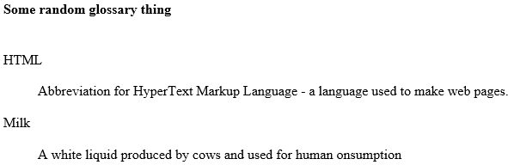
HTML – Fundamentals Lists
Description list
<h4>Some random glossary thing</h4>
<dl>
<dt>HTML</dt>
<dd>Abbreviation for HyperText Markup Language - a language used to make web pages.</dd>
<dt>Milk</dt>
<dd>A white liquid produced by cows and used for human consumption </dd>
</dl>

Slide 40
HTML – Fundamentals Tables
An HTML table is defined with the <table > tag.
Each table row is defined with the <tr> tag.
A table header is defined with the <th> tag. By default, table headings are bold and centered.
A table data/cell is defined with the <td> tag.
Attribute | Value | Description
align | left center right | Specifies the alignment of a table according to surrounding text
bgcolor | rgb(x,x,x) #xxxxxx colorname | Specifies the background color for a table
border | 0 1 | Specifies whether or not the table is being used for layout purposes
cellpadding | pixels | Specifies the space between the cell wall and the cell content
cellspacing | pixels | Specifies the space between cells
width | pixels % | Specifies the width of a table

Slide 41
HTML – Fundamentals Other uses of Images
Table background
<table background-image=“url”>
<table class=“background”>
table.background { backlground-image:url; }

Slide 42
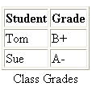
HTML – Fundamentals Tables Example
<TABLE>
<CAPTION ALIGN="bottom">Class Grades</CAPTION>
<TR>
<TH>Student</TH>
<TH>Grade</TH>
</TR>
<TR>
<TD>Tom</TD>
<TD>B+</TD>
</TR>
<TR>
<TD>Sue</TD>
<TD>A-</TD>
</TR>
</TABLE>

Slide 43

HTML – Fundamentals Tables
<TABLE BORDER=1 WIDTH=“60%" CELLPADDING=“6” CELLSPACING=“2” ALIGN="RIGHT">
<CAPTION ALIGN="bottom">Class Grades</CAPTION>
<TR>
<TH>Student</TH>
<TH>Grade</TH>
</TR>
<TR>
<TD>Tom</TD>
<TD>B+</TD>
</TR>
<TR>
<TD>Sue</TD>
<TD>A-</TD>
</TR>
</TABLE>

Slide 44
HTML – Fundamentals Tables
colspan To make a cell span more than one column.
rowspan To make a cell span more than one row.

Slide 45
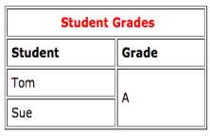
HTML – Fundamentals Tables
<TABLE BORDER=1 WIDTH="50%" CELLPADDING=5 ALIGN="center">
<TR>
<TD colspan=2 align='center'>
<font color="red"><b>Student Grades</b></font>
</TD>
</TR>
<TR>
<TD><b>Student</b></TD>
<TD><b>Grade</b></TD>
</TR>
<TR>
<TD>Tom</TD>
<TD rowspan=2>A</TD>
</TR>
<TR>
<TD>Sue</TD>
</TR>
</TABLE>

Slide 46
Screen Compatibility
1280 x 1024
1024 x 768
800 x 600
640 x 480

Slide 47
HTML – Fundamentals Tables
Tables are frequently used to layout the basic web page design.
1280
640

Slide 48
HTML – Fundamentals Frames
Frames let you divide a screen into windows with each window viewing a different web page.
Frame types
Basic Frames
Floating Frames (inline frames)
Picture in picture

Slide 49
HTML – Fundamentals 1- Basic Frames
Banner
Menu | Content
Footer

Slide 50
HTML – Fundamentals 1- Basic Frames
Basic tags
<frameset> ..</frameset>
<frame />
<noframes> .. </noframes>
Basic attributes of frameset
cols = “values”
rows = “values”
Frameborder="yes|no"|0| 1
Border =pixels
framespacing=pixels
Bordercolor="#hexcolor|colorname"
name = “frame_name”

Slide 51
HTML – Fundamentals 1- Basic Frames
Individual FRAME attributes
src=url/file name
scrolling="yes|no|auto"
Noresize=noresize
marginwidth=pixels
Marginheigth="pixels"
name=“text(frame_name)”

Slide 52
HTML – Fundamentals 1- Basic Frames
<frameset rows="80,*,80">
<frame src="banner.html"/>
<frameset cols = "25%,75%" >
<frame src="menu.html" />
<frame src="content.html" />
</frameset>
<frame src="footer.html" />
</frameset>
Banner
Menu | Content
Footer

Slide 53
HTML – Fundamentals 1- Basic Frames
<frameset rows="80,*,80">
<frame src="banner.html"/>
<frameset cols = "25%,75%" >
<frame src="menu.html" />
<frame src="content.html" />
</frameset>
<frame src="footer.html" />
<noframes>
<body>
Welcome to my page.
<A HREF="noframes.htm">Continue</A>
to the frame-free version.
</body>
</noframes>
</frameset>
Banner
Menu | Content
Footer

Slide 54
HTML – Fundamentals 2- Floating Frames
Floating frames allow you to create a frame within the boundaries of a page
Basic Frames
Floating Frames

Slide 55
HTML – Fundamentals 2- Floating Frames
<IFRAME attributes > </IFRAME>
Attributes
SRC=URL
Height=pixels|percent,
Width=pixels|percent
Hspace=pixels
Vspace=pixels
Align =left|right
Name = text
Frameborder=0|1

Slide 56
HTML – Fundamentals 2- Floating Frames
Example :
<IFRAME
NAME=“frame_name”
ALIGN="right"
HSPACE=“40”
VSPACE=“40”
WIDTH="75%"
HEIGHT=“150”
FRAMEBORDER=0
SRC=“http://www.mysite/mypage.htm “ >
</IFRAME>

Slide 57
HTML – Fundamentals DIV and ILAYER
Allows you create a position-able block of content.
Content positioned within this block
Definition and Usage
The <div> tag defines a division or a section in an HTML document.
The <div> tag used as a container for HTML which is then styled with CSS or manipulated with JavaScript.
The <div> tag is easily styled by using the class or id attribute.
Any sort of content can be put inside the <div> tag
Note: By default, browsers always place a line break before and after the <div> tag element.

Slide 58
HTML – Fundamentals DIV
<div attributes> content </div>
attributes
ID=“name”
STYLE = “style parameters : CSS”

Slide 59
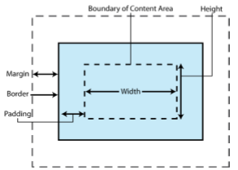
HTML – Fundamentals DIV
< DIV ID=“fred”
STYLE = “ POSITION: absolute| relative| fixed;
VISIBILITY : visible : hidden;
Z-INDEX :number ;
WIDTH : width in pixels;
HEIGHT : height in pixels;
TOP: pixels from top of page or block;
LEFT : pixels from left edge of page or block;
PADDING : margin in pixels;
other style attributes; “ >
content
</DIV>

Slide 60
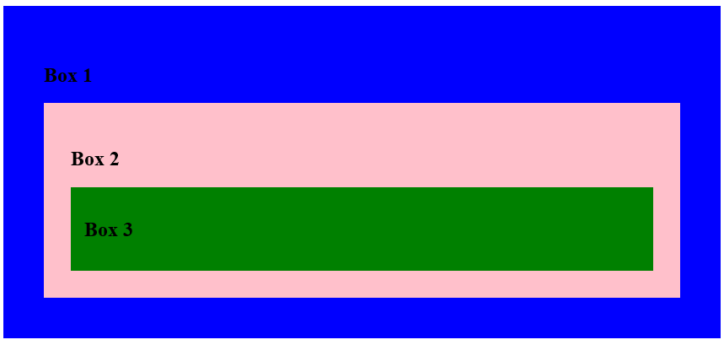
Nested Div
<div style="background-color:blue ; padding:3px ; margin-top:1px">
<h2>Box 1</h2>
<div style="background-color:pink ; padding:2px ; margin-top:1px">
<h2>Box 2</h2>
<div style="background-color:green ; padding:1px ; margin-top:1px">
<h2>Box 3</h2>
</div>
</div>
</div>

